Slide 1
CENSUS INCOME data
GROUP 6 -
Akash Gupta
Chandra Megha Penchala
Samarth Khare
Sruthi Theddu
Suraj Arvind Mhetre
Tanmayi Vetukuri

Slide 2
DATA DESCRIPTION
Source: U.S. Census Bureau (United States Department of Commerce)
Data Type: Multivariate
This data set contains weighted census data extracted from the 1994 and 1995 current population surveys conducted by the U.S. Census Bureau. The data contains demographic and employment related variables

Slide 3
Data Observations
Number of instances in data = 199523
Duplicate or conflicting instances: 46716
VARAIBLES:
Family Details: ARACE, AAGE, ASEX, AREORGN, AMARITL, SELF..
Educational Details: AHGA, AHSCOL
Business Details: INCOME, AMJIND, AMJOCC, WKSWORK..

Slide 4
Research Questions
Determine whether the income level of a person exceeds over $50,000 per year
How income is controlled by race, age and sex
How the above factors discriminate female’s role in employment

Slide 5
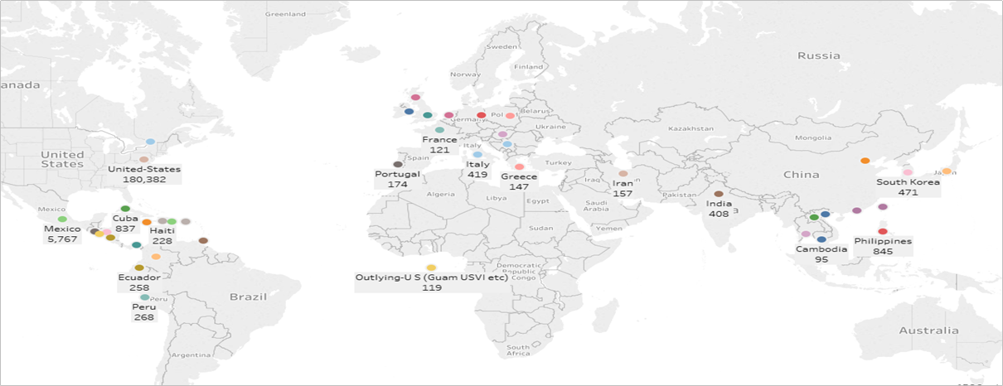
Population Distribution
Here is the distribution of People across different countries in the data set.

Slide 6
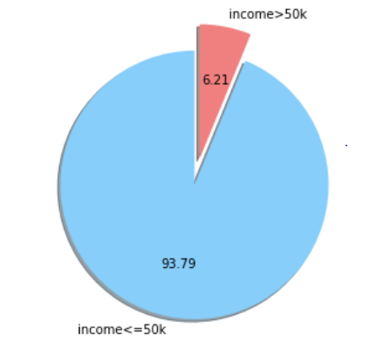
DISTRIBUTION OF INCOME
About 93.79% of population have income <= 50k
About 6.21% of population have income > 50k

Slide 7
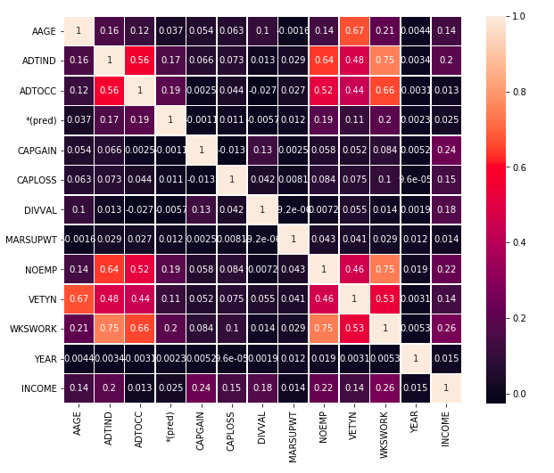
CORRELATION MATRIX
A correlation matrix is a table showing correlation coefficients between variables
Each cell in the table shows the correlation between two variables

Slide 8
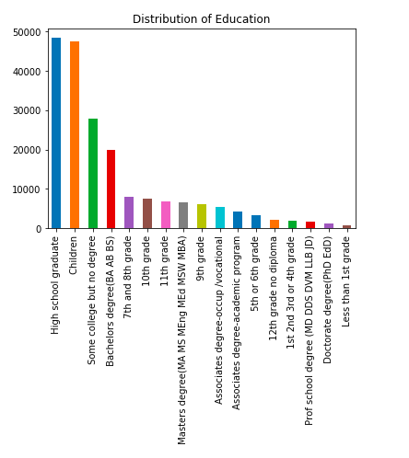
DISTRIBUTION OF EDUCATION
Majority of people in dataset are high school graduates

Slide 9
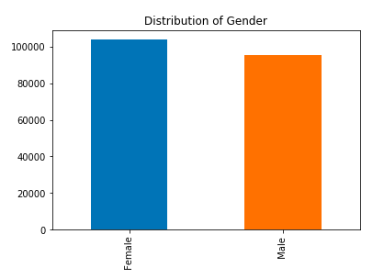
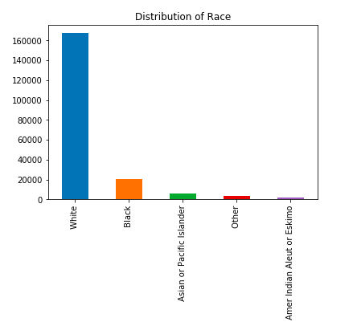
DISTRIBUTION OF RACE & GENDER

Slide 10
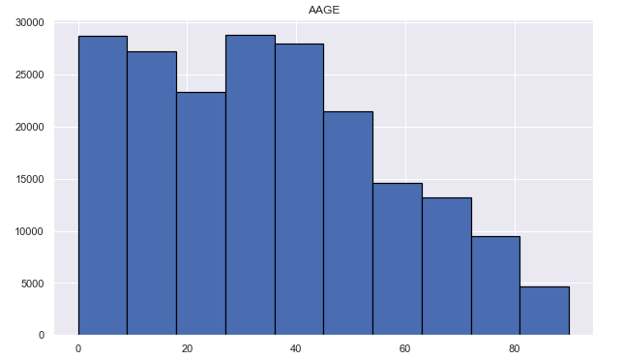
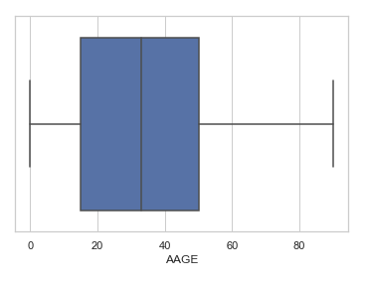
Distribution of age

Slide 11
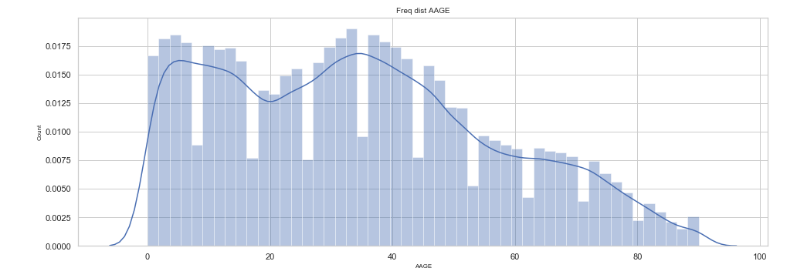
Frequency distribution for Age

Slide 12
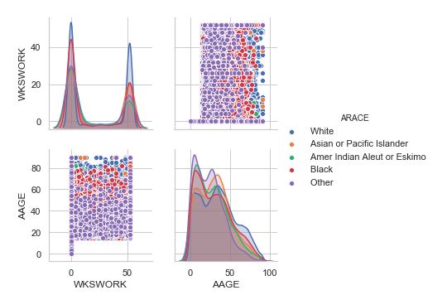
PAIR PLOT BETWEEN AGE & WORK
Shows different levels of a categorical variable by the color of plot elements.

Slide 13
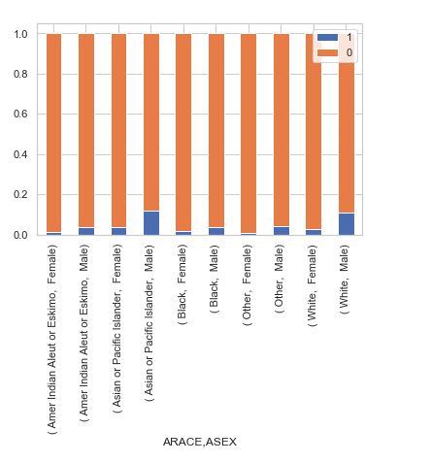
RACE & GENDER aFFECTING INCOME

Slide 14
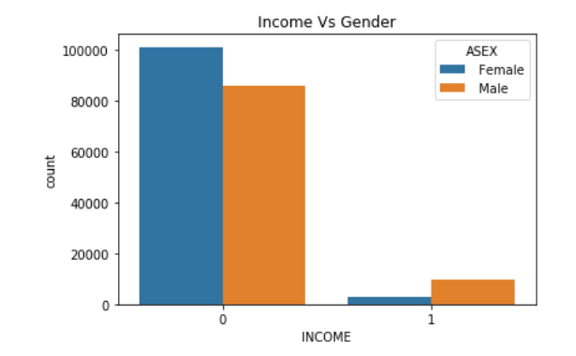
HOW GENDER EFFECTS INCOME
The graph displays gender gap in income

Slide 15
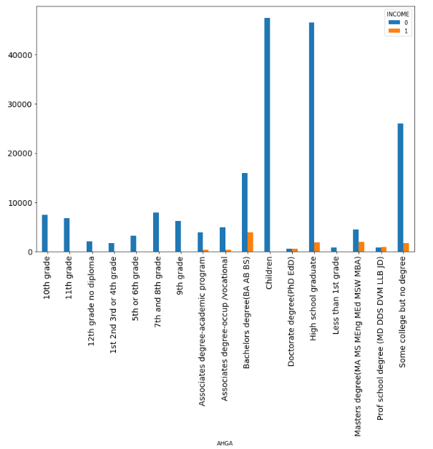
A person who has Bachelors Degree has more probability to gain income > 50k

Slide 16
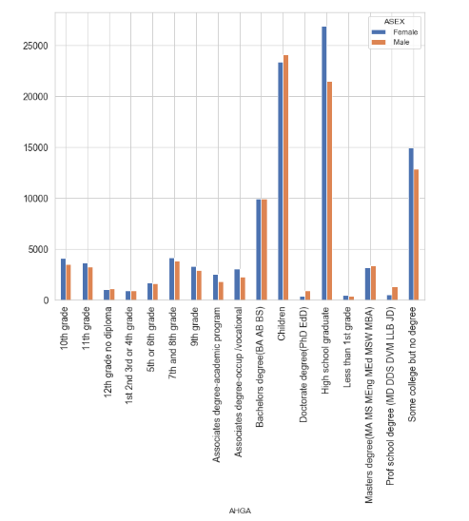
Highest Level of Education Vs Gender

Slide 17
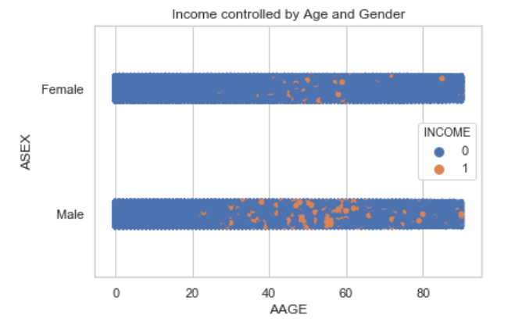
HOW INCOME IS CONTROLLED BY AGE AND GENDER
Males in the age group 35-60 have income > 50k whereas females in the age group 40-60 have income > 50k

Slide 18
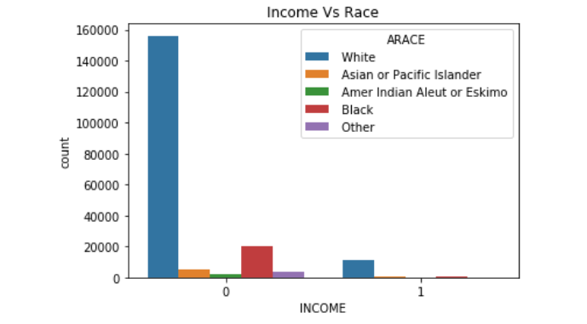
HOW RACE AFFECTS INCOME
White people tend to have more income in both categories i.e. income <=50k and income > 50k

Slide 19

Data cleaning
We removed following columns from the dataset
- 'MIGMTR1', 'MIGMTR3', 'MIGMTR4','MIGSUN','*(pred)','AGI’,'AHRSPAY'
These columns had more than 95 thousand missing values per column
Removing records corresponding to these columns would result in lesser number of dataset observations.
Imputing these many records with mean, mode etc. would make data biased.
Predicting these many records would make final income predictions unreliable

Slide 20
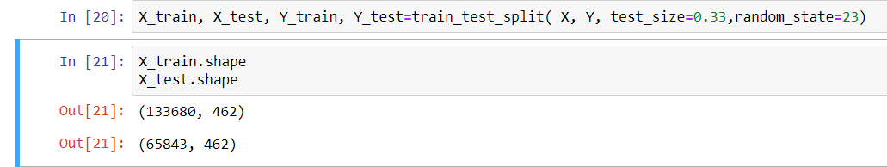
Data cleaning
Columns | FATHER | MOTHER | SELF | GRINST
No. missing values | 6713 | 6119 | 3393 | 708
Imputed mode values for above columns with categorical data
Imputed mode values in place of irrelevant values already present in the data.
Created dummy variables for all categorical fields for classification results.
Split the data into training and testing for model evaluation

Slide 21
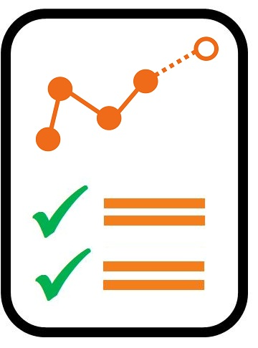
Model evaluation
Logistic Regression
K Nearest Neighbors
Linear Discriminant Analysis
Random Forest
Decision Trees

Slide 22
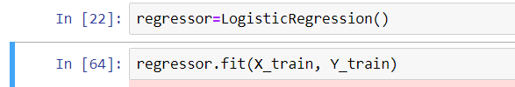

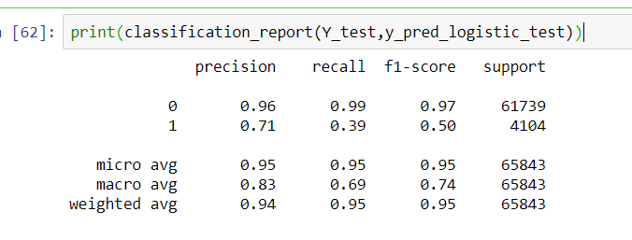
Logistic regression
A binary logistic model has a dependent variable with two possible
values, such as pass/fail or win/lose are represented by an indicator variable
where the two values are labeled "0" and "1"

Slide 23
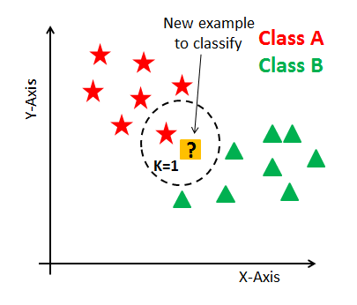

K NEarest neighbors
k-NN is a type of lazy learning where the function is only approximated
locally and all computation is deferred until classification.
The k-NN algorithm is among the simplest of all machine learning algorithms.
Taking k = 5
Small k values – Higher influence on the result
Large k values – Computationally expensive

Slide 24
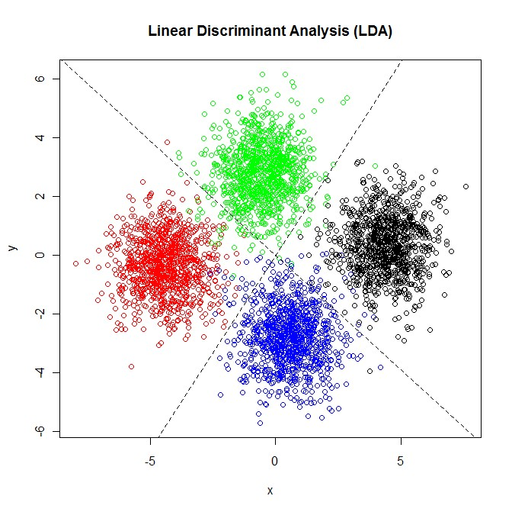
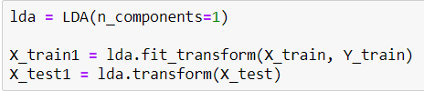
Linear discriminAnt Analysis
Express one dependent variable as a linear combination of other features or measurements.
LDA is intended for classification problems where the output variable is categorical.
LDA supports both binary and multi-class classification.

Slide 25


Random forest
Operates by constructing a multitude of decision trees at training time and outputting the class that is the mode of the classes (classification) or mean prediction (regression) of the individual trees.
Random decision forests correct for decision trees' habit of overfitting to their training set

Slide 26
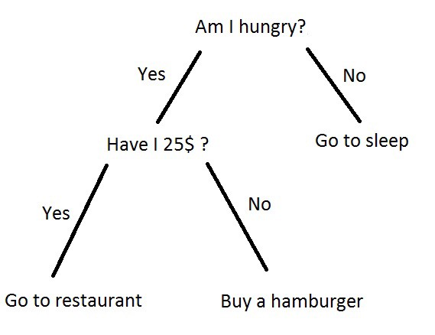
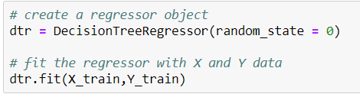
Decision Trees
A decision tree is a flowchart-like structure in which each internal node
represents a "test" on an attribute(e.g. whether a coin flip comes heads or tails)
uses a tree-like model of decisions and their possible consequences
It is one way to display an algorithm that only contains conditional control
statements.

Slide 27

MODEL ACCURACY COMPARISONS
MODEL | ACCURACY
LOGISTIC REGRESSION | 95.1839 %
K NEAREST NEIGHBORS | 93.9765 %
LINEAR DISCRIMINANT ANALYSIS | 94.4352 %
RANDOM FOREST | 94.9075 %
DECISION TREES | 93.1853 %

Slide 28
MODEL aic comparisons
MODEL | AIC
LOGISTIC REGRESSION | 907.8763
K NEAREST NEIGHBORS | 907.4289
LINEAR DISCRIMINANT ANALYSIS | 907.5873
RANDOM FOREST | 907.7647
DECISION TREES | 907.1821
The Akaike information criterion (AIC) is an estimator of the relative
quality of statistical models for a given set of data.
Thus, AIC provides a means for model selection.

Slide 29
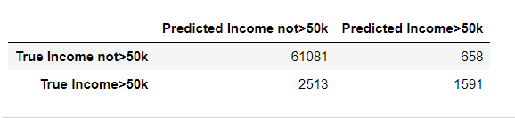
Sensitivity and specificity
Model | Sensitivity | Specificity
LOGISTIC REGRESSION | 96.05% | 70.74 %
K NEAREST NEIGHBORS | 95.28% | 53.36 %
LINEAR DISCRIMINANT ANALYSIS | 96.81% | 55.77 %
RANDOM FOREST | 95.62% | 70.33 %
DECISION TREES | 96.42% | 45.41 %
Sensitivity (also called the true positive rate, the recall, or probability
of detection in some fields) measures the proportion of actual
positives that are correctly identified as such.
Specificity (also called the true negative rate) measures the proportion of actual negatives that are correctly identified as such .

Slide 30
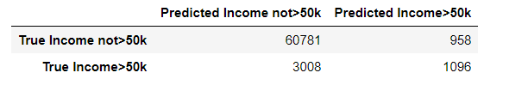
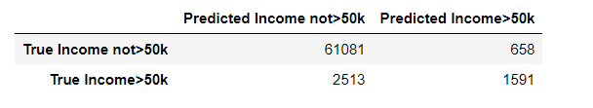
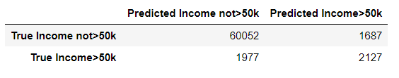
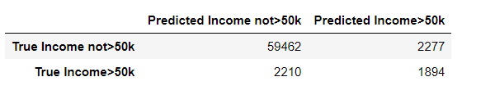
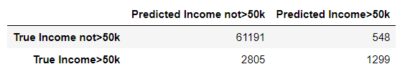
ConfuSION mATRICES.............?
KNN
LOGISTIC MODEL
LDA
DECISION TREES
RANDOM FOREST

Slide 31
HOW ANALYSED DATA CAN BE USED ?
Spreading awareness among schools and colleges to maintain gender equality during on-campus placements
We can target the 6% population with income > 50k for fundraising and starting campaigns for women empowerment
Establish structures, policies, objectives in every organization to ensure gender balance

Slide 32



